Slide 1

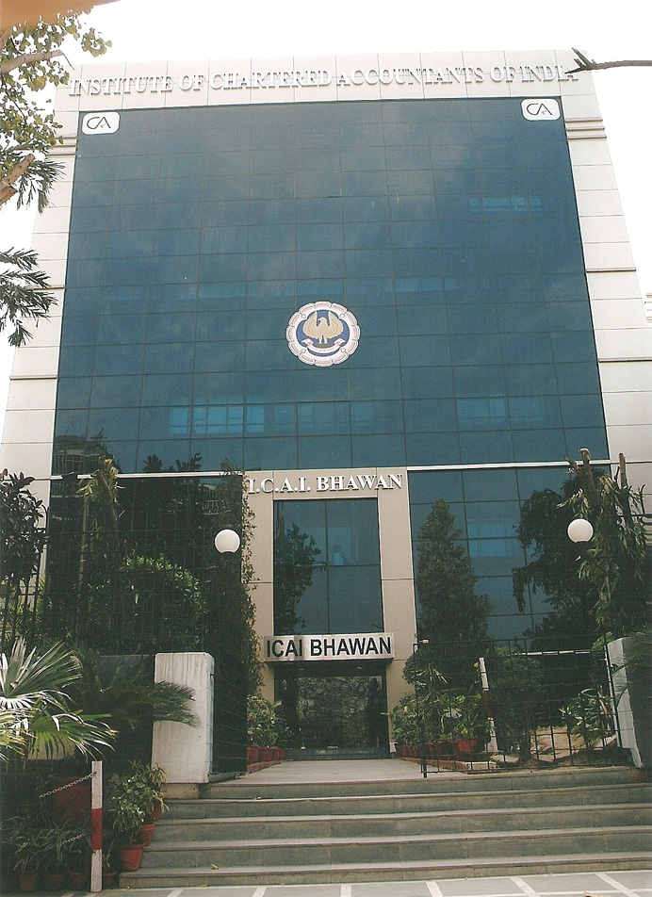
Spearheading Professional Excellence
The Institute of Chartered Accountants of India
Established by an
Act of Indian Parliament
“The Chartered Accountants Act, 1949”

Slide 2
Our Mission
The Indian Accountancy Profession will be the Valued Trustee of World Class Financial competencies, Good Governance and Competitiveness

Slide 3
Profile of ICAI
Was set up in 1949 under the Chartered Accountants Act, 1949 even before adoption of Constitution of India in 1950
Since then Profession has grown leaps and bounds in terms of Membership
and Student base

Slide 4
Profession in India
265K+ Members spread throughout the country and in different parts of the world
Sizeable studentship base
Increase in percentage of members joining industry
Chartered Accountants are rendering services in every walk of economic life - Politics, Judiciary, Government, Agriculture, Corporate, NGOs
Profession is dominated by small firms
Increasing trends towards consolidation
Government of India looks at ICAI as Partner in Nation Building

Slide 5
ICAI Profile
Particulars | No.
ORGANIZATIONAL
Regional Offices | 5
Branches | 163
Chapters Abroad | 30
MEMBERSHIP (‘000) | 265
STUDENTS (‘000) | 821

Slide 6
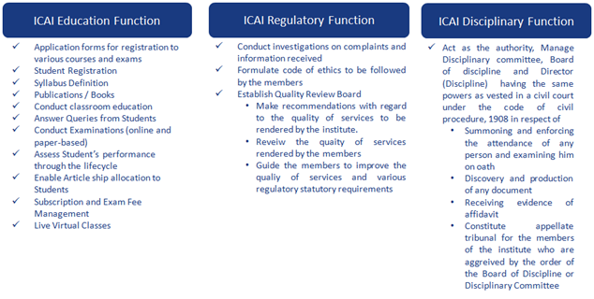
ICAI AT A GLANCE

Slide 7
Role of ICAI
To regulate the profession of Accountancy
Education & Examination of Chartered Accountancy
Exercise Disciplinary Jurisdiction
Input on Policy matters to Government
Ensuring Standards of performance of Members
Formulation of Accounting Standards
Prescription of Engagement and Quality Control Standards
Laying down Ethical Standards
Continuing Professional Education
Financial Report Review
Monitoring Quality through Peer Review
Conducting Post Qualification Courses
Focus on Capacity Building in the emerging context

Slide 8
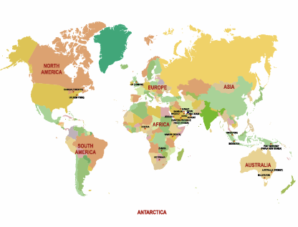
ICAI Overseas
ICAI has 30 chapters abroad out of which 8 chapters are based in Middle East region

Slide 9
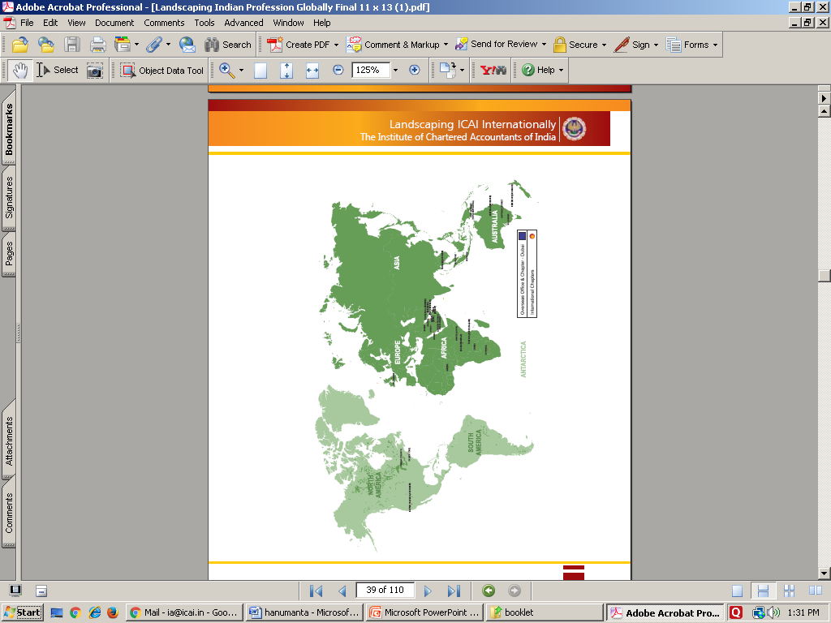
ICAI’s Chapters Abroad
Africa–Middle East | Abu Dhabi | Dubai | Kuwait |  | Tanzania (Dar Es Salaam)
 | Bahrain | Nigeria | Eastern Province (Saudi Arabia) |  | UAE (Ras Al Khaimah)
 | Botswana | Jeddah | Oman (Muscat) |  | Uganda (Kampala)
 | Doha | Riyadh | Kenya (Nairobi) |  | Zambia
Australasia Oceania | Australia (Melbourne) |  | Brisbane |  | Australia (Sydney)
 | New Zealand (Auckland) |  | Port Moresby (Papua New Guinea)
Asia | Indonesia |  | Thailand (Bangkok) |  | Singapore
Europe | UK (London) | Netherlands (Amsterdam)
North America | US (New York) | Vancouver (British Columbia) |  | USA (San Francisco) |  | Canada (Toronto)

Slide 11
The Central Council
Consisting of 40 Members
  32 Elected Members
  8 Nominated by Central Government
Term: Three years
Headed by President
  Elected by the Council for one year term
Empowered to frame Regulations under the Act and to constitute necessary standing and non-standing Committees

Slide 12
Standing Committees
Executive
Committee
Finance
Committee
Examination
Committee
Disciplinary
Committee
(Section 21D)

Slide 13
Non-Standing Committees
Accounting Standards Board | Committee for Co-Operatives and NPO Sectors | Editorial Board | Peer Review Board
Audit Committee | Committee on International Taxation | Ethical Standards Board | Public Relations and CSR Committee
Auditing & Assurance Standards Board | Corporate Laws & Corporate Governance Committee | Expert Advisory Committee | Professional Development Committee
Board of Studies | Committee for Professional Accountants in Business & Industry | Financial Reporting Review Board | Research Committee
Banking, Financial Services and Insurance Committee | Committee on Management Accounting | Indirect Taxes Committee | Infrastructure Development Committee
Committee on Accounting Standards for Local Bodies | Committee on Public Finance and Government Accounting | International Affairs Committee | Management Committee
Committee for Capacity Building of Members in Practice | Committee for Members in Entrepreneurship and Public Service | Internal Audit Standards Board | Valuation Standards Board
Committee on Economic, Commercial Laws & WTO, and Economic Advisory | Continuing Professional Education Committee | Coordination Committee with Sister Institutes | Global Digital Accounting and Assurance Board
Committee on Information Technology | Direct Taxes Committee | Ind AS (IFRS) Implementation Committee

Slide 14
Institute Functions
Professional Development
Regulatory
Advisory

Slide 15
ICAI – A Key National Body
Offers inputs to
Comptroller & Auditor General of India
Ministry of Corporate Affairs, Govt. of India
Reserve Bank of India
Securities and Exchange Board of India
Central Board of Direct Taxes
Insurance Regulatory and Development Authority
Departments of Central and State Governments
Departments of Public Enterprises

Slide 16
Important Initiative Undertaken to Align with Changing Economic Order
Convergence with International Standards of Accounting and Auditing
Review and Revision of Education and training curriculum
Launch of Post Qualification Courses Capacity building of firms
Mandatory CPE Requirement
Peer Review Mechanism
Financial Report Review
Brand building – Nationally and Internationally
Focused approach on issues relating to Corp. Governance.
Facilitating changes in regulatory frames.
Vigorous pursuance of Mutual Recognition Agreements.
Arrangement with Universities for graduation qualification to CA students
Facilitating accounting reforms in various areas

Slide 17
Examples of Involvement of ICAI in National Organizations
Drafting of Income Tax Laws
Drafting of Competition Law
Drafting of Company Law
Capital Market – Development and Regulation
Corporate Governance
Accounting & Utilization of Governmental resources
WTO & GATS
GST
Commercial and Economic Legislations

Slide 18
Education and Training
Distant Mode of Education
Education Through Accredited Institutions, Branches, e-lectures, video lectures and web casts.
Comply with the requirements of international educational pronouncements of IFAC
Comprehensive and contemporary theoretical and practical curriculum
Continuous review and revision of the curriculum

Slide 19
Examination
One of the largest Accounting examination networks
Administrative conduct of examination and exam related process largely computerized
Exams are held twice a year
Examination system considered to be of high standard & integrity worldwide
Has been lending expertise to accounting bodies in other countries

Slide 20

CPE
ICAI has always been striving for excellence in terms of standards of professional services rendered by its members.
In this age of information explosion and the rapid changes in technology, trade and industrial environment, the need for continual professional updation is supreme.
To enable members to maintain the high standards of professional services, the CPEC is providing continued inputs to members by way of Seminars, Lectures, Background Material and use of the electronic media. This provides the sharpening of our professional skills so that the word 'Chartered Accountant' is synonymous with excellence in services. More than 7500 CPE Programs are held annually by CPE Organising Units.
It ensures that the members remain continuously updated with respect to developments in existing and emerging disciplines and subject specific areas directly or indirectly related to the profession and to help impart necessary skills to the members so that knowledge thus garnered by them gets translated into practice.
CPE requirements have been made mandatory for all the members of the ICAI, whether he/she be in practice or in service and such system is measured, monitored and managed scientifically.

Slide 21
Professional Ethics
Cardinal Principles
  Service before self
  Extends beyond the legal requirements
Some major highlights
Prohibition on other “business/occupation”
Prohibition on solicitation
Prohibition on advertisement and Canvassing
Prohibition on substantial interest in the auditee
Restriction on number of audits
Limit on fees for non-audit assignments of the auditor
Prohibition on writing Books of Accounts of Auditee company
Independence between External and Internal Auditors
Professional fees for audit and other services received by a firm not to exceed 40% of the gross annual fees of the firm received from clients under the same management

Slide 22
Professional Development
Identifying Role of Profession in emerging areas
Developing Practice Areas
Upgrading and updating the knowledge and skill sets
Developing technical material to facilitate practice in new areas
Considered as critical in the changed Scenario

Slide 23
Quality Control Initiative – Peer Review
Peer Review Board of established in March 2002
Focus on:
  Compliance with Technical, Professional and Ethical Standards
  Quality of Reporting
  Systems and procedures for carrying out assurance services
  Training programmes for staff (including articled and audit assistants) concerned with assurance functions, including availability of appropriate infrastructure
  Compliance with directions and / or guidelines issued by the Council to the Members
  Compliance with directions and / or guidelines issued by the Council relating to article assistants and / or audit assistants.

Slide 24
Quality Review Board
Central Government has constituted Quality Review Board consisting of 11 persons.
Council of ICAI has nominated 5 members on QRB
Chairman and other 5 members have been appointed by Central Government
As per the provisions of Sec. 28B of the CA Act, 1949 the Quality Review Board :-
  a) Makes recommendations to the Council with regard to the quality of services provided by the members of the Institute;
  b) Reviews the quality of services provided by the members of the Institute including audit services; and
  c) Guides the members of the Institute to improve the quality of services and adherence tot he various statutory and other regulatory requirements.

Slide 25
Financial Reporting Review Board
The Financial Reporting Review Board was established in July 2002 as a non-standing Committee of the Council of the ICAI with a view to bring an overall improvement in the quality of services being rendered by the members of the profession.
The Board reviews the general-purpose financial statements of certain enterprises with a view to determine, to the extent possible:
  Compliance with the generally accepted accounting principles in the preparation and presentation of financial statements;
  Compliance with the disclosure requirements prescribed by regulatory bodies, statutes and rules and regulations relevant to the enterprise; and
  Compliance with the reporting obligations of the enterprise as well as the auditor.

Slide 26
The FRRB may review the general purpose financial statements and the auditor’s report of the following enterprises:
    Enterprises selected either suo motto or
    Enterprises referred to it by any regulatory body like, Reserve Bank of India, Securities and Exchange Board of India, Insurance Regulatory and Development Authority, Ministry of Company Affairs, etc or
    Enterprises wherein serious accounting irregularities have been highlighted by the media reports.
Action, if any, Non-Compliance observed: In case, the FRRB finds any non-compliance, it is classified in the following categories:
    Non-compliance, not so material
    Material Non-compliance
In cases where non-compliances, not so material, are observed by the Board which do not affect the true and fair view of financial statements, the FRRB would appropriately bring the non-compliance to the attention of the auditor.

Slide 27
In cases where material non-compliance are observed by the Board which affects the true and fair view of financial statements, it may :
Action against the Auditor(s): refer the case to the Director (Discipline) of the Institute of Chartered Accountants of India for initiating action against the auditor under the Chartered Accountants Act, 1949.
Action against the Enterprise: Insofar as the management of the enterprise is concerned, pending the grant of relevant powers to the FRRB by the Government of India, the FRRB would inform irregularity to the regulatory body relevant to the enterprise.

Slide 28
Enterprises within purview of FRRB
Entities whose equity or debt securities are listed or are in the process of listing on any stock exchange, whether in India or outside India.
Banks (including co-operative banks), financial institutions or entities carrying on insurance business.
All commercial, industrial and business reporting entities, whose turnover (excluding other income) exceeds rupees fifty crore in the immediately preceding accounting year.
Holding and subsidiary entities of any one of the above.
Such other category of enterprises which in the opinion of the Board make the public interest vulnerable due to susceptibility to non-compliance of generally accepted accounting principles in the preparation and presentation of financial statements, non-compliance of the disclosure requirements prescribed by regulatory bodies, statutes and rules and regulations relevant to the enterprise and non-compliance of the reporting obligations of the enterprise and the auditor.

Slide 29
ROBUST DISCIPLINARY MECHANISM
The Disciplinary Committee consists of 3 persons nominated by the Council and 2 nominated by Government of India.
Presence of Government nominee is a must for all Disciplinary Committee proceedings.
Strict action is taken against a member who is found to be guilty of professional misconduct with punishment getting tougher depending on the nature of misconduct including award of maximum penalty of Rs. 5 lakhs and also permanent removal in rare cases.
From the year 2016-17, two benches of Disciplinary Committee have been constituted for expeditious disposal of pending cases.
Amendments to the Chartered Accountants Act, 1949 & Rules framed thereunder relating to disciplinary mechanism are under consideration for removing procedural difficulties and enabling fast-track disposal.

Slide 30
International Presence
ICAI is founder member of IFAC, CAPA SAFA and IIN.
ICAI is represented in:
  IFAC - As Board Member, Small and Medium Practices Committee (SMP Committee) and International Auditing and Assurance Standards Board (IAASB)
  Chartered Accountants Worldwide (CAW)
  CAPA – As Deputy Presidency; Chair, Public Sector Financial Management Committee and Member, PAO Development Committee
  SAFA – As Board Member and member of various Committees & Working Groups (ICAI holds Permanent Secretariat, SAFA)
  Asian Oceanian Standard Setters Group (AOSSG)- As member
  International Innovation Network – As Member
  Member, International Valuation Standards Council

Slide 31
International Presence-contd..
ICAI being consulted by IAASB in Audit Standards Setting and by IASB in IFRS setting
Playing a lead role in the area of Developing Nations, SMPs and SMEs, International Public Sector Accounting Standards, International Education Standards
ICAI plays an important role in the standard setting process of the National Standard-Setters and World Standard-Setters.
Participate in the accountancy , corporate reporting, governance sustainability reporting and allied areas in the meetings organized by UNCTAD, OECD, GRI and various other multilateral forums.

Slide 32
International Initiatives
ICAI has signed MoUs with the following accounting Institutes world wide:-
S. No | Entered With | Subject/Title | Country/Group | Status
1. | The Institute of Chartered Accountants of England & Wales (ICAEW) | MoU | UK | Active
2. | CPA Australia | MRA | Australia | Active
3. | Chartered Accountants Australia & New Zealand | MoU | Australia & New Zealand | Under Governmental approval
4. | CPA Ireland | MRA | Ireland | Under Governmental approval
5. | CPA Canada | MoU | Canada | Under Renewal
6. | The Institute of Chartered Accountants of Pakistan (ICAP) | MoU | Pakistan | Under Governmental approval
7. | The Institute of Chartered Accountants of Nepal (ICAN) | MoU | Nepal | Under Renewal
8. | The South African Institute of Chartered Accountants (SAICA) – | MoU | South Africa | Under Governmental approval

Slide 33
International Initiatives Contd.
S. No | Entered With | Subject/Title | Country/Group | Status
9. | National Board of Accountants and Auditors, Tanzania | MoU | Tanzania | Under Governmental approval
10. | CPA Kenya | MoU | Kenya | Under Governmental approval
11. | Saudi Organization for Certified Public Accountants (SOCPA) | MoU | Saudi Arabia | Under Governmental approval
12. | CPA Afghanistan, DG Treasury, Ministry of Finance, Afghanistan | MOU | Afghanistan | Under Governmental approval

Slide 34
International Initiatives (Technical)
S. No | Entered With | Subject/Title | Country/Group | Status
1. | College of Banking & Financial Studies, Oman | MoU | Oman | Active
2. | Higher Colleges of Technology, Dubai | MoU | UAE | Under Renewal
3. | Saudi Organization for Certified Public Accountants (SOCPA) | TC | Saudi Arabia | Active
4. | Accounting and Auditing Standards Board of Bhutan | TC | Bhutan | Active
5. | Information Systems Audit & Control Association | License Agreement | California, USA | Active

Slide 35
MoU / MRA on anvil
Talks are progressively on with the following Accounting Institutes for signing MoU with ICAI:
  The Institute of Chartered Accountants in Zimbabwe

Slide 36
ICAI – Towards Virtual Institute
‘Virtual Institute’ integrates all the regions and offices to present a unified view of the operations of the entire Institute through a single integrated enterprise system
It FULFILLS the members and students right to convenience, comfort and make the benefits of Information Technology (IT) available to the members and students for rendering the Institute services online anywhere-anytime
With this all operational functions of the institute have been brought onto a common intranet with seamless flow and availability of information
Towards Tomorrow → Today
  ICAI started IT initiative towards a bright future and is in it today
ICAI Portal is effectively used to make a repository of information and knowledge accessible to the members, students and employees at the click of a button.
The portal brings dynamic features to the content. It functions as a Global Gateway to ICAI. The portal’ provides a single interface to users for accessing Institute’s services taking into consideration security requirements.

Slide 37
Transformation journey
ICAI will provide students, members, government, stakeholders with a centralized digital platform to improve and optimize the interactions with the Institute while ensuring high and improved turnaround in service times. ICAI will ensure complete visibility and accessibility to the information to the authorized end users ensuring its reliability and accuracy.
ICAI will actively engage in building a reliable, available and secure infrastructure platform embracing Green computing principles across the value chain in its effort to reduce paper usage across its offices. ICAI will pioneer the adoption of Green Computing and set a benchmark across its peer Institutes in the world.
ICAI will enable its employees across HO, RO and Branch offices to have visibility and access to the information with best of the breed user experience across all touch points. ICAI will actively pursue establishing a standard operating environment of its digital technology platform leveraging licensed software across all its offices thereby better optimizing the efficiencies of scale. ICAI will automate the processes and sub-process where possible to release time and energy of its employees from mundane / non-productive tasks into more productive tasks at the Institute.
ICAI will aggressively pursue enablement of students and members, firms and other related entities in the emerging areas of accounting and auditing profession thereby ensuring timely availability of professional skill sets in the marketplace leading to better distribution of the opportunity pie across the members and students of ICAI.ICAI considers Information Technology (IT) as one of the key enablers in this transformation journey and will frame an IT Strategy and roadmap to realize the vision. ICAI looks forward to establishing a robust, secure, scalable, modular and reliable organizational IT infrastructure which can help realize the promise and vision of the Institute.

Slide 38
The Institute is responsive to the emerging challenges and constitutes new committees for effectively meeting newer challenges

Slide 39

The Institute of Chartered Accountants of India
[Set up by an Act of Parliament]
“ICAI Bhawan”, Indraprastha Marg, New Delhi – 110 002.
Phone: 91-11-39893989, 30110210
Website: www.icai.org

